Slide 1
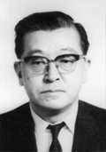
Ishikawa’s 7 Pillars of Wisdom
Kan Ch 5
Steve Chenoweth, RHIT
Notes:
TE Lawrence’s book cover, from http://www.examiner.com/article/love-lawrence-of-arabia-read-the-seven-pillars-of-wisdom-the-book-the-movie-was-based-on.
Kaoru Ishikawa’s picture, from http://www.vectorstudy.com/management-gurus/kaoru-ishikawa.

Slide 2
Part of the “language of QA”
Your software QA people should know what all these things are.
Other QA people in engineering use the same tools / terms.
Helps in connecting about quality, with other organizations.

Slide 3
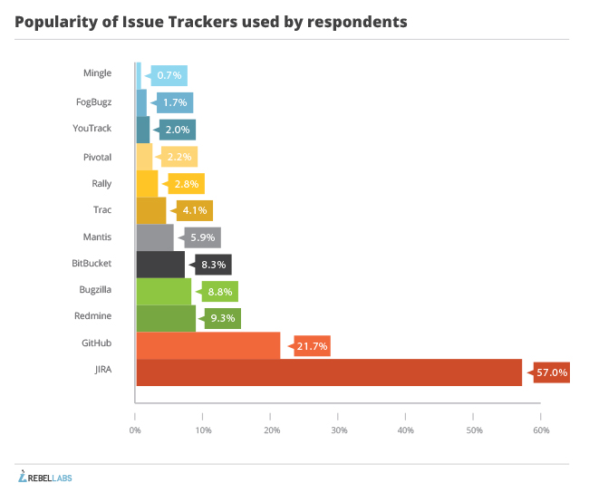
Simple “tools”
Could in fact be done with spreadsheets, etc.
Also may be part of QA packages.
Or regular development-related systems, like for issue tracking.
Right - What’s popular? Issue trackers, 2013:
Notes:
Chart from http://zeroturnaround.com/rebellabs/developer-productivity-report-2013-how-engineering-tools-practices-impact-software-quality-delivery/11/.

Slide 4
Example
Notes:
JIRA report image from https://www.atlassian.com/software/jira/service-desk.

Slide 5
Back to Ch 5: Here they are…
They started out for process and quality control,
At the project and organization level.
Some apply easily to software development.
Some – rather tricky to apply!
Notes:
Kan p 129

Slide 6
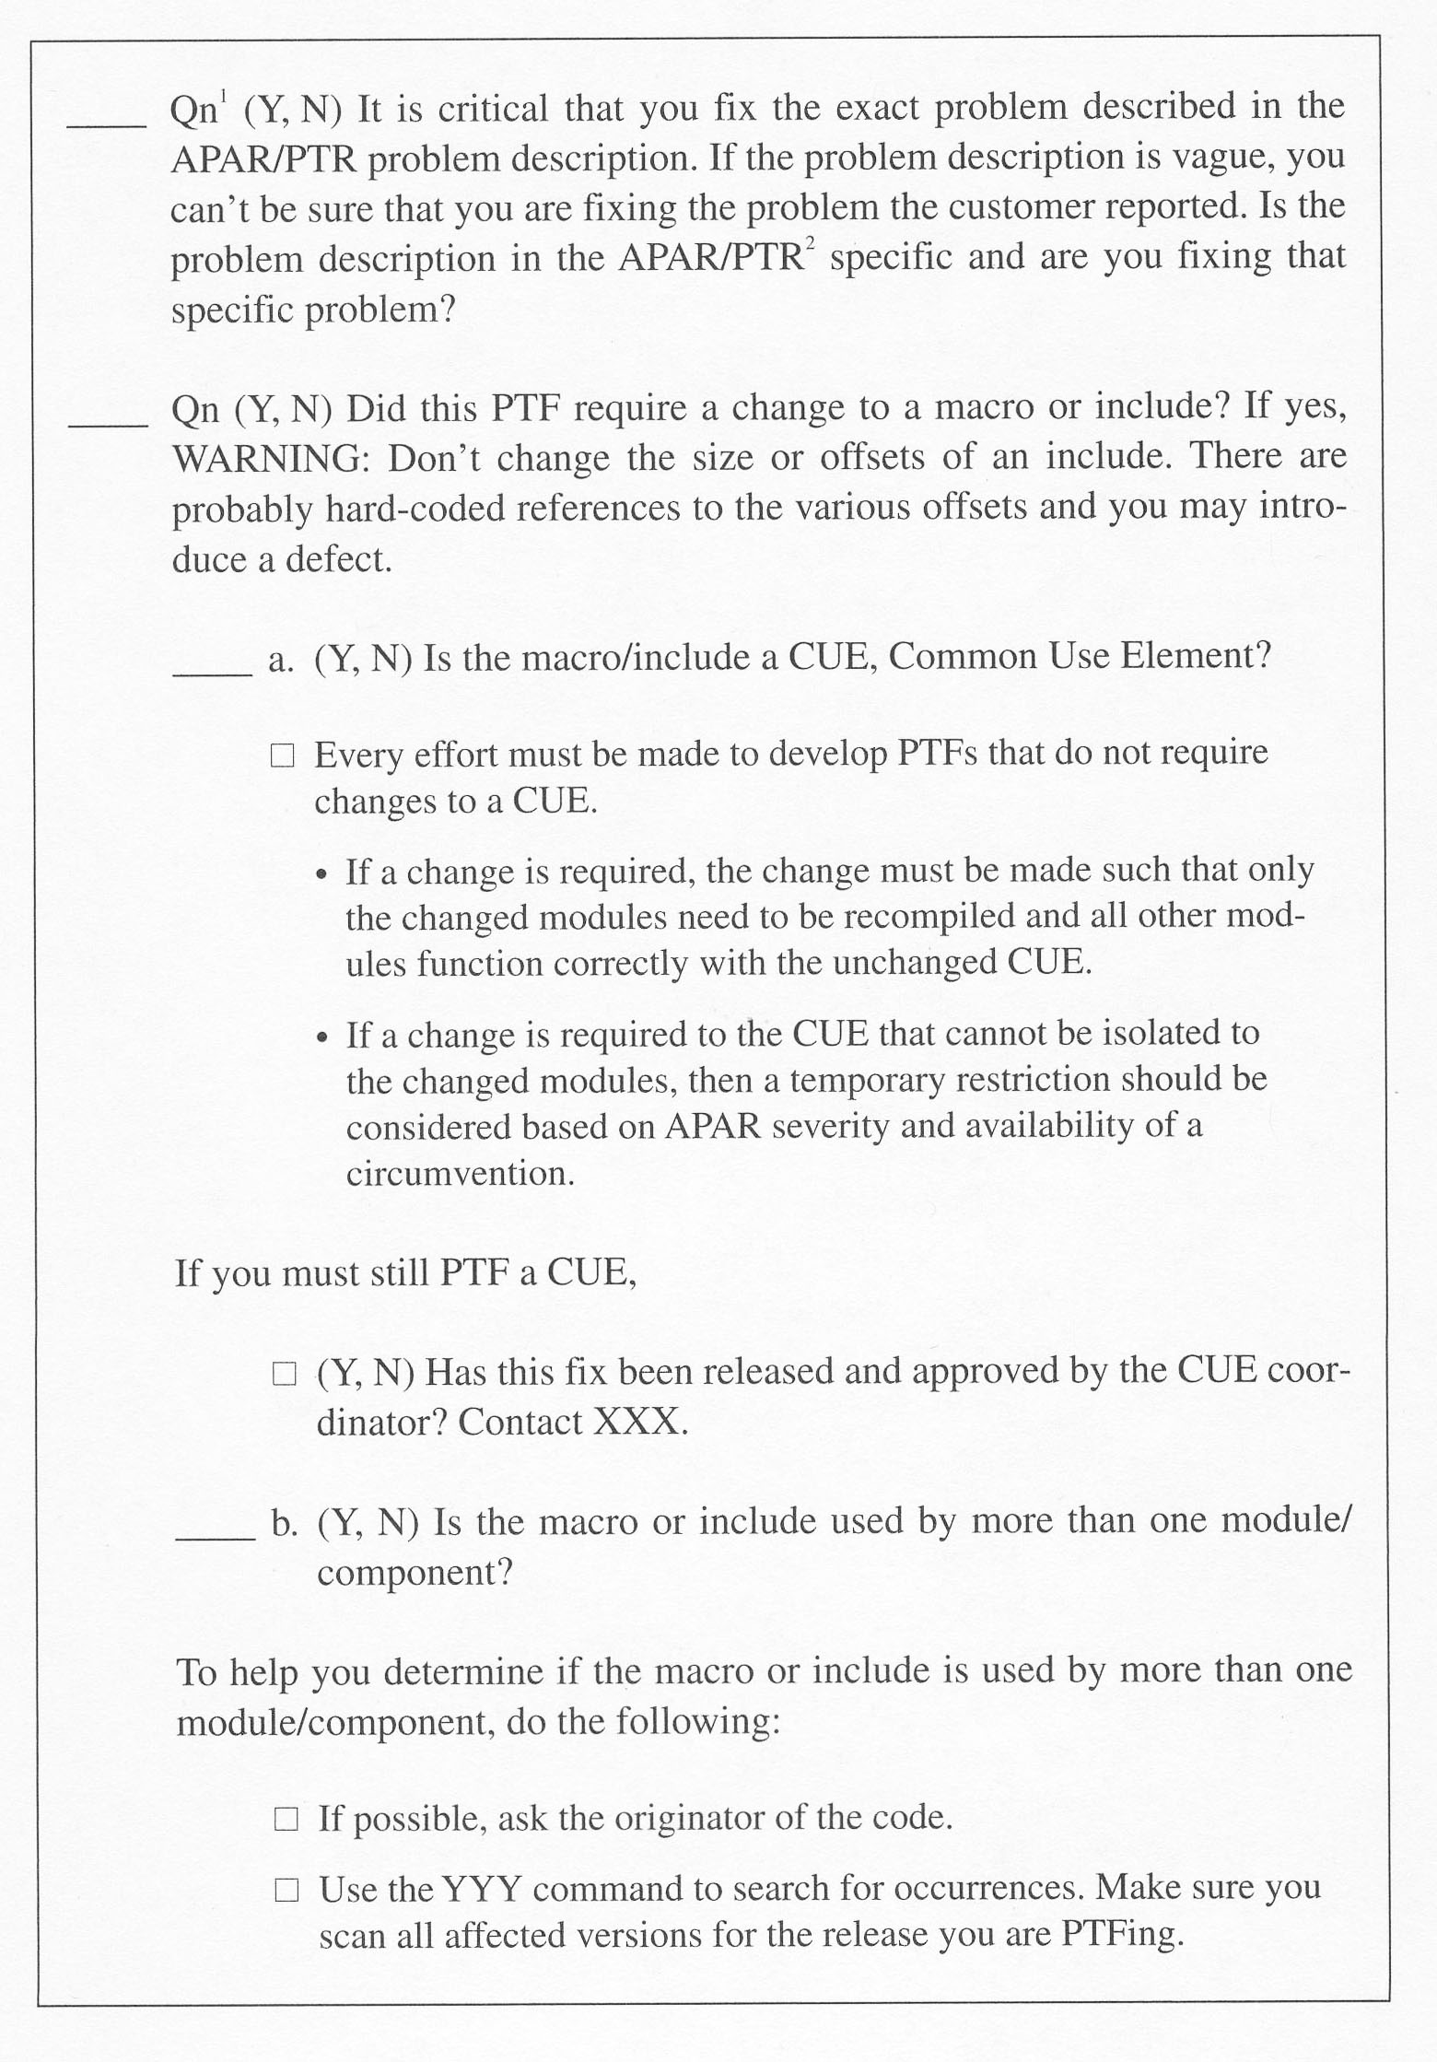
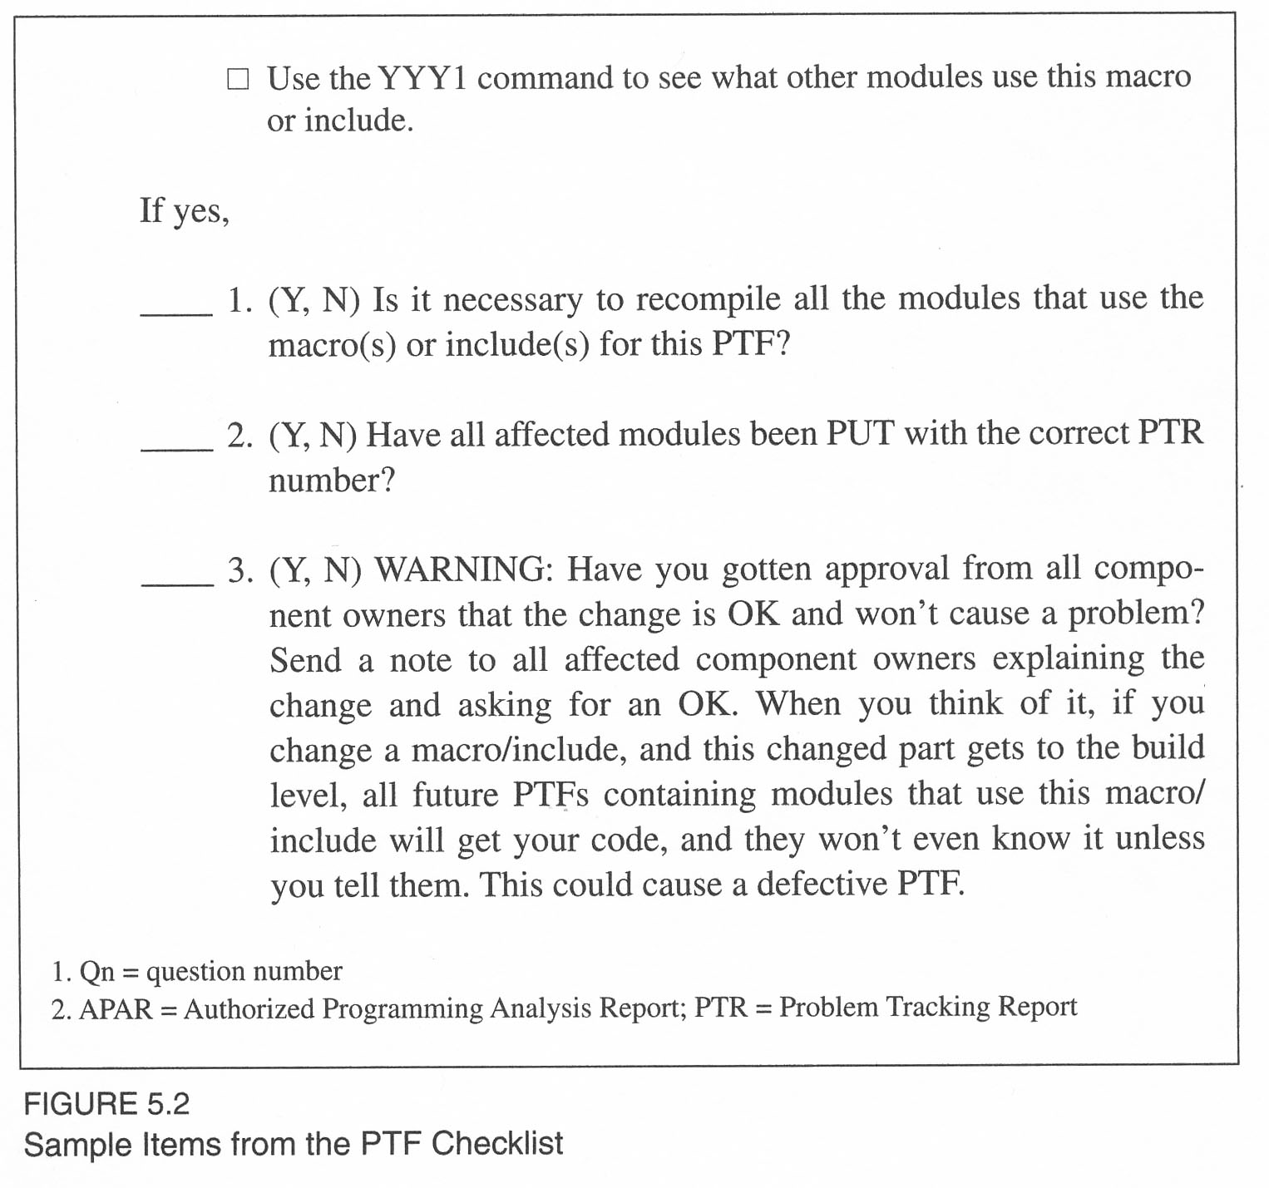
Great example
IBM Rochester’s “PTF Checklist”
PTF = Program temporary fix
Goal = Help reduce defective fixes
Notes:
Kan pp 132-3

Slide 7
80 / 20 Rule, anyone?
In this Pareto chart:
Two groups of problems
Were dominant defect causes.
Thus, let’s work on reducing those!
Notes:
Kan p 134

Slide 8
Histograms – some other ordering vs percentage attributed to it
To be a “histogram,” the second axis just has to be “orderable,” or we have a bar chart!
Notes:
Kan p 137

Slide 9
Run charts
“What did they do here, to fix things!?
Notes:
Kan pp 138-9

Slide 10
Scatter Diagrams
How would you interpret this one?
Notes:
From Kan, p 141. His analysis is on p 140.

Slide 11
Lots of ways to explore these, like:
Notes:
Kan p 142

Slide 12
Or:
Notes:
Kan p 143

Slide 13
Control charts – trouble, because…
Specs for software metrics are low quality.
Software is design and development, not manufacturing.
Multiple common causes for software defects.
Multiple processes are used.
Hard to relate process limits to end-product quality.
Notes:
Kan pp 144-5.

Slide 14
A good try
Conclusion – Maybe best used for maintenance?
Notes:
Kan p 148

Slide 15
Cause-and-effect diagrams
Negative ones!
Notes:
Kan p 153

Slide 16
Cause-and-effect diagrams
Positive ones!
Notes:
Kan p 153

Slide 17
There are new ones to consider, too
Notes:
Kan p 155

Slide 18
What does Kan recommend for small organizations?
These tools aren’t hard to implement.
Good for status reporting:
Run charts
Histograms
Bar charts
Checklists! (Short!)
Pareto diagrams – useful for analysis.
Notes:
Kan p 157
Image from http://www.sap.com/solution/sme/software/erp/small-business-management/demos.html.

